Slide 1


UBER VS LYFT
AKSHITA CHAWDHARY  ABHILASH KEDLAYA
HYE KIM  ALTAN ORHON  NEELAM PURSWAMI

Slide 2
Executive Summary
Introduction
Uber has been in the media for its questionable business practices. While Lyft, on the other hand, has not had as much negative publicity. The case study team was intrigued by how the public perception and ethics played into shaping the top two (U.S.) rideshare companies’ business strategies. Furthermore, the team was interested in exploring the impact ethics had on the businesses themselves.
Purpose
The purpose of the case study is to compare Uber and Lyft’s internal and external factors, and future goals to evaluate which will be operating in the next 5 years.
Findings
The team conducted PEST Analysis; Porter’s Five Forces; and evaluation of both company’s corporate social responsibility, structure, leadership, and culture. Based on the current state of each company, the team predicts that both will be operating in the next 5 years while Uber still maintains the lead and the majority of the market shares.
Recommendations
The team acknowledges there will still be a gap, however, the following recommendations are for the purposes of future planning. The goal of the recommendations is to avoid the presented predictions based on current data and analysis.
The recommendations for Uber are to: 1) replace current Chairman, 2) provide ethics business practices training to all employees, 3) remove stacked ranking system with 360 feedback system.
The recommendations for Lyft are to: 1) create a third part ethics committee, 3) specifically target areas where Uber has been explicitly rejected, 3) create strategic partnerships with companies with similar values.

Slide 3
Table of Contents
01
02
03
04
Background
External Factors
Internal Factors
Overview
Quick Facts
Objective
PEST Analysis
Porter’s Five Forces
Corporate Social Responsibility
Structure
Leadership
Culture
SWOT Analysis
05
06
07
08
Future Goals
Predictions
Recommendations
References
Future goals and strategies for Uber and Lyft
Predictions based on current state of companies
Recommendations for Uber based on predictions
Recommendations for Lyft based on predictions
Works cited

Slide 4


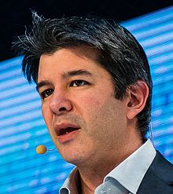
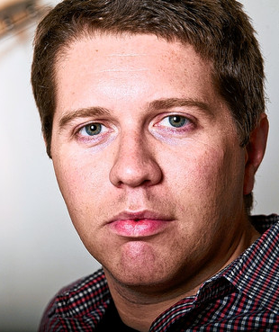


Quick Facts
"Our mission is to reconnect people through transportation and bring communities together.“ - Lyft
“Transportation as reliable as running water, everywhere for everyone.” - Uber
Founder: Travis Kalanick
Founder: Garrett Camp
Founder: Logan Green
Founder: John Zimmer
OBJECTIVE: The objective of this case study is to evaluate and determine which company is in a better position to be sustainable in the market in the next five years. The team will present an analysis of the internal and external factors, summarize the future goals of each company, and then make predictions based on the current status of each company. The team will then present recommendations to lessen the potential negative impact and/or gaps made in the predictions.
Uber was founded by Travis Kalanick and Garrett Camp in March 2009. Uber is currently operating in 696 cities and 84 countries (Uber Inc., 2017) with approximately 70% of the market share (intext citation). Uber was last valued at approximately $68 billion (Bensinger, 2017).
Lyft was founded in June 2012. Lyft is currently operating in 302 cities (U.S. only) (Lyft Inc., 2017) and currently holds approximately 30% of the market share (intext citation). Lyft was last valued at approximately $ 11 billion (Shontell and Lebowitz, 2017).

Slide 5




PEST Analysis
The PEST Analysis aims to takes into account external political, economic, sociocultural, and technological factors as they have a significant impact on the ridesharing industry, and how both Uber and Lyft shape their strategies
Political
Economic
The rideshare industry is influenced by laws and regulations concerning labor, especially as regards the treatment of drivers as employees (Cetin & Deakin, 2017); the environment, such as emissions limits for commercial vehicles (Schwanz, 2016); privacy, such as rules that govern how rider and driver data should be stored (Newcomer, 2017); and trade, by rules that dictate how, where, for what price, and in how many numbers any sort of driving service is allowed to operate (Cetin & Deakin, 2017) . In some areas, specific legislation has been introduced to regulate ridesharing (Di Caro, 2014). Traditional service providers, such as taxi cabs, hold considerable political influence in certain areas, and lobby to keep companies like Uber and Lyft out of their territories (Badger, 2014; Taylor, 2016). These parties’ arguments frame ridesharing companies as illegitimate businesses whose drivers have an unfair advantage over licensed taxi drivers, especially in places where only limited number of taxis are allowed, and raise questions over safety and liability (Cetin & Deakin, 2017). Few places remain in the U.S. that have managed to keep Uber and Lyft out. For example, Austin, Texas was forced to allow them back in 2017 despite a local referendum in 2016 on whether the companies should have to follow background check requirements like other driving services, which resulted in their departure from Austin after they were unsatisfied by the result, by a governor’s order that overrode local authority (Associated Press, 2017). Taxi drivers in other parts of the world have been more successful in keeping Uber out of their territories, which will affect Lyft’s expansion plans. In several countries, including Italy, Denmark, and France (where cab drivers protested violently), ridesharing services have been fined high amounts for failing to register as taxicab service providers, or even banned completely (Rhodes, 2017).
Although it is standard in the ridesharing industry for the driver to cover fuel costs, the impact of fluctuations in the price of gas could influence drivers’ willingness to use the service. Gas prices are considered low but still volatile today (Meredith, 2017). The size of the labor market is also influenced by the unemployment and underemployment rate, as people with full-time jobs are less likely to become drivers. According to a PayScale study, 46% of Americans report being underemployed, defined as “as having part-time work but wanting to work full-time, or holding a job that doesn't require or utilize [one’s] education, experience, or training” (PayScale, 2017). Combined with stagnating wage growth (Shambaugh & Nunn, 2017), this motivates people to seek extra jobs to supplement their income. These people are attracted to driving due to the flexibility it affords and the low barriers to entry. Uber’s own survey of drivers in 2015 found that 69% of drivers use the platform to supplement income from another job, and that 88% chose it because it was easy to work into their existing schedules (Uber Technologies, 2015). The on-demand economy of which ridesharing is part is transforming how people think about labor and consumption alike (Montgomery, 2015). The convenience of a service brought to the customers’ feet at whatever time they please is, for many, acceptable and preferable to waiting for a bus, which operates on its own route and schedule (Clewlow & Mishra, 2017).

Slide 6




PEST Analysis (continued)
Sociocultural
Technological
Economic factors that push more people to seek additional jobs to supplement their income blur the line between categories of customers, contractors, and employees; drivers are all three, at times, while customers could become drivers at any moment. This fluidity extends to other sharing economy services, such as AirBnb, and its result is the marketization and commodification of social relationships and culture (Lewer, 2016). The provider exchanges privacy—a measurable human need (Acquisti, Brandimarte, & Loewenstein, 2015)— into “alienated commodities with exchange value … These forms of labor intensify the pressure to commodify one’s life” (Standing, 2015). One example of broader social impact of this is seen in how the gentrification brought by AirBnb has transformed neighborhoods in cities worldwide into tourist ghettos by pushing out the residents who comprised their communities (Posner, 2017).
An important sociocultural development in the U.S. this year has been increased awareness of sexual harassment, especially in the workplace, culminating in the #MeToo movement that started in October, which encouraged victims to discuss their experiences openly (Gilbert, 2017). Earlier, in February, ex-Uber employee Susan Fowler shared an essay about her experience of being sexually harassed at Uber, and how the company protected those responsible. The impact of that essay has been such that The New York Times titled an October interview with her, “She’s 26, and brought down Uber’s CEO. What’s next?”, referring to the ouster of Travis Kalanick in June. Fowler is on TIME Magazine’s cover, with three other women who broke their silence on sexual harassment, as one of the “Silence Breakers” who are, collectively, the magazine’s “Person of the Year” (TIME, 2017). The sociocultural climate of U.S. makes it crucial for businesses to take sexual harassment much more seriously than in the past.
Other than vehicles, the crucial technology ridesharing apps depend on is the smartphone. In the U.S., smartphone penetration is upward of 80% (Knight, 2017). The most significant factors that will impact ridesharing in the future are technologies that could reduce fuel costs and environmental impact, such as electric vehicles, and autonomous/self-driving/driverless vehicle technology (Gartner, 2017). One manufacturer of autonomous vehicles, General Motors, has stated that it expects its cars to be suitable for ridesharing by 2019 (Welch, 2017). The possibility of replacing human drivers with AI ones has implications for businesses (e.g., reduced labor costs) , workers (fewer jobs for unskilled workers), and safety (potential reduction in accident rates) (Welch, 2017). In August 2016, then-Uber CEO Travis Kalanick summarized the advantage that the first company to bring autonomous vehicles to ridesharing would have as follows: "If we are not tied for first, then the person who is in first, or the entity that's in first, then rolls out a ride-sharing network that is far cheaper or far higher-quality than Uber's, then Uber is no longer a thing” (Carson, 2016)

Slide 7
Porter’s Five Forces
What are the competitive forces that shape competition in the ridesharing industry?
Threat of New Entrants
Bargaining Power of Buyers
The essential technology behind the software for ridesharing services is easy to implement (Konczal, 2014). However, the marketing costs and time needed to acquire enough drivers and riders for a well-functioning service, the increasing necessity of political and legal expertise, and low prospects for short-term profitability (Molla & Bhuiyan, 2017) make the threat to Uber and Lyft of new entrants to the ridesharing market low.
Buyers—riders—have high bargaining power in this industry. They are inundated with easily accessible options and real-time information about changing price conditions, to which they are highly sensitive. Social issues also lead buyers toward other options, as Uber discovered with the #DeleteUber Twitter campaign that was launched in response to what was seen as Uber taking advantage of a strike in New York (Molla & Bhuiyan, 2017).
Industry Rivalry
Although the concentration ratio of the industry is high, in that the combined market shares of Uber and Lyft add up to nearly the entire market (Molla & Bhuiyan, 2017), the antagonistic relationship of the two—which has included allegations of espionage and anticompetitive business practices (O’Brien & Bensinger, 2017)—make competitive rivalry a tremendous force.
Bargaining Power of Suppliers
Threat of Substitutes
Suppliers in this market are the drivers. As preconditions for becoming a driver for Uber or Lyft are minimal, they are abundant and replaceable, in this economy—and few remain drivers in the long term (Gaus, 2015). Drivers may demand rights and benefits usually afforded to employees, and they could unionize, but with weak labor protections in the U.S. (Bensinger, 2017), the bargaining power of suppliers is low.
The threat of substitutes to ridesharing is considerable. Alternatives include traditional taxis, public transit, short-term car rental (e.g., ZipCar), biking, and walking. A 2017 study in seven major U.S. cities found that ridesharing reduced public transit use but had no significant impact on personal car ownership and use. The study also found that around half of ridesharing trips would have been made not at all, or by transit, walking, or biking, if ridesharing were unavailable (Clewlow & Mishra, 2017).
Notes:
Bensinger, G. (2016, November 23). Uber, Lyft oppose Seattle’s draft union rules. The Wall Street Journal. Retrieved from https://www.wsj.com/articles/uber-lyft-oppose-seattles-draft-union-rules-1479936176
Clewlow, R. R., & Mishra, G. S. (2017). Disruptive transportation: The adoption, utilization, and impacts of ride-hailing in the United States. Ucd-Its-Rr-17-07, (October). Retrieved from https://itspubs.ucdavis.edu/wp-content/themes/ucdavis/pubs/download_pdf.php?id=2752
Gaus, A. (2015, October 23). Uber, Lyft drivers may not stick around for long, SherpaShare survey finds. The San Francisco Business Times. San Francisco. Retrieved from https://www.bizjournals.com/sanfrancisco/blog/techflash/2015/10/uber-lyft-drivers-leave-tech-startup-churn-vc.html
Konczal, M. (2014). Socialize Uber. Retrieved December 5, 2017, from https://www.thenation.com/article/socialize-uber/
Molla, R., & Bhuiyan, J. (2017). Uber hasn’t recovered its business in San Francisco and New York since #deleteUber - Recode. Retrieved December 5, 2017, from https://www.recode.net/2017/11/8/16617798/uber-delete-uber-lyft-market-share-sales
O’Brien, R. D., & Bensinger, G. (2017, September 8). Uber faces FBI probe over program targeting rival Lyft; investigators looking at whether Uber’s defunct “Hell” internal program was used to interfere illegally with competitors. The Wall Street Journal. New York, NY.

Slide 8
Social Responsibility
A company’s approach to social responsibility—"the way its managers and employees view their duty or obligation to make decisions that protect, enhance, and promote the welfare and well-being of stakeholders and society as a whole”—can be classified as obstructionist, defensive, accommodative, or proactive (Jones & George, 2016, p. 116). Where do Uber and Lyft stand on this scale?
Obstructionist
Defensive
Accommodative
Proactive
Uber
Lyft
Uber has been a model practitioner of the obstructionist approach to social responsibility (Jones & George, 2016, p. 115). Uber continually demonstrated, over the course of several years, dishonesty and unethical and illegal behavior. It has consistently tried to stop the spread of information about that behavior to other organizational stakeholders and society at large. Uber has done this so frequently that it seems to be ingrained in the company’s culture, and its tainted reputation has been affecting its ability to do business—when the City of London recently revoked its license to operate in that city named Uber’s reputation as a decisive factor in its decision (Bershidsky, 2017). Uber has flouted regulations brazenly in numerous cities, not only with regard to its ridesharing service but also its autonomous vehicles (Geuss, 2016). It has developed software to delude regulators in Portland, Austin, and Philadelphia by identifying inspectors and stopping them from getting rides (O’Brien & Bensinger, 2017). It is under federal investigation for alleged theft of proprietary information on self-driving cars from Waymo, a company backed by Google parent Alphabet (O’Brien & Bensinger, 2017), and for alleged bribery in multiple Asian countries, which is illegal under the the Foreign Corrupt Practices Act (Ingram, 2017).
An October 2016 data breach, with personally identifying information of more than 50 million riders and 7 million drivers, that Uber purposefully covered up until November 21, 2017 (Khosrowshahi, 2017), despite a federal legal obligation to report such breaches immediately, is in early stages of investigation as well. Uber admitted to paying the hackers $100,000 to delete the data and keep the attack quiet (Newcomer, 2017). Uber has been fined before for failing to disclose a data breach (Bershidsky, 2017).
Lyft can be described as following an accommodative approach, where the company has generally avoided spectacular legal and ethical transgressions (Jones & George, 2016, p. 115), and has used this as a way to develop its competitive advantage. Lyft CEO John Zimmer even described Lyft as “woke,” “a better boyfriend” in January 2017, on the heels of a social media campaign to #DeleteUber after Uber was used to bypass a New York City cab drivers’ strike against the policies of President Trump (Steinmetz, 2017). Lyft donated $1 million to the ACLU in response to Trump’s immigration ban, which was seen as an attempt to further ride a wave of good press (Steinmetz, 2017). Lyft has not had many public ethical transgressions the way Uber has—no spectacular data breaches, harassment scandals, accusations of espionage or thievery. Lyft has had ethical and legal problems, too;, but these have been about issues that are common to Uber and the business model of for-profit, non-employee-owned ridesharing services in general (Somerville, 2017). These, along with the frequently reactive (generally to Uber) nature of Lyft’s social actions and rhetoric, disqualify Lyft’s approach from being considered proactive. Lyft’s approach goes beyond satisfying legal requirements, and there are significant cultural aspects ingrained in the company that contribute to positive behaviors (Buchanan, 2017), so its approach is closer to accommodative than to defensive.
Notes:
Bershidsky, L. (2017). Uber’s big problem Is a culture of dishonesty - Bloomberg. Retrieved November 22, 2017, from https://www.bloomberg.com/view/articles/2017-11-22/uber-s-big-problem-is-a-culture-of-dishonesty
Buchanan, L. (2017). Lyft’s CEO on creating a great company culture. Retrieved December 6, 2017, from https://www.inc.com/magazine/201506/leigh-buchanan/logan-green-on-employee-recognition.html
Geuss, M. (2016, December 16). Uber, defiant, says it won’t apply for an autonomous car permit in California. Ars Technica. Retrieved from https://arstechnica.com/cars/2016/12/uber-defiant-says-it-wont-apply-for-an-autonomous-car-permit-in-california/
Ingram, D. (2017). What is at stake for Uber in U.S. bribery probe? Retrieved November 22, 2017, from https://www.reuters.com/article/us-uber-corruption/what-is-at-stake-for-uber-in-u-s-bribery-probe-idUSKCN1BW0HH
Jones, G. R., & George, J. M. (2016). Contemporary management (9th ed.). New York, NY: McGraw-Hill Education.
Khosrowshahi, D. (2017). 2016 data security incident. Retrieved November 22, 2017, from https://www.uber.com/newsroom/2016-data-incident/
Newcomer, E. (2017). Uber paid hackers to delete stolen data on 57 billion people - Bloomberg. Retrieved November 22, 2017, from https://www.bloomberg.com/news/articles/2017-11-21/uber-concealed-cyberattack-that-exposed-57-million-people-s-data
O’Brien, R. D., & Bensinger, G. (2017, September 8). Uber faces FBI probe over program targeting rival Lyft; investigators looking at whether Uber’s defunct “Hell” internal program was used to interfere illegally with competitors. The Wall Street Journal. New York, NY.
Somerville, H. (2017). Judge approves $27 million driver settlement in Lyft lawsuit. Retrieved November 22, 2017, from https://www.reuters.com/article/us-lyft-drivers/judge-approves-27-million-driver-settlement-in-lyft-lawsuit-idUSKBN16N30D
Steinmetz, K. (2017, September). How Lyft is capitalizing on Uber’s scandals. TIME.

Slide 9
Structure
Insert a blurb about why structure is important factor and should be considered. What does it affect? What styles are good? Why does this matter in the context of our analysis?
https://
Uber follows a more Weberian architecture in terms of its structure where the top management takes most of the decisions (intext citation). The authority is centralized and the employees do not participate in most of the decision making. The implications of such a type of structure at Uber is that the employees do not feel an active part of the decision making at the company. Moreover, because of such a structure a negative implication in the work style of the employees was the, the employees would be asked to work till late night in the company which slowly seeped into the culture of the company. WHAT ARE THE IMPLICATIONS OF HAVING THEIR CURRENT STRUCTURE. IS IT GOOD? IS IT BAD? ETC. ETC.
Lyft has a flattened more flexible hierarchy where the company follows a collaborative decision making approach (intext citation). There is decentralization of authority and the employees contribute in decision making intext citation). The implication of such a structure is that the employees at Lyft feel empowered and they are encouraged to find their own ways to perform their duties and solve problems. There are collaborative decisions made to solve any problem with an ongoing product. ← WHAT DOES THIS MEAN? YOU ALSO NEED SOMETHING TO TRANSITION INTO THIS STATEMENT. Also, need to cite …unless it is your analysis. In that case, you need to lay out your reasoning a bit more.
WHAT ARE THE IMPLICATIONS OF HAVING THEIR CURRENT STRUCTURE. IS IT GOOD? IS IT BAD? ETC. ETC.
www.thoughtco.com
www.alamy.com
Notes:
https://www.thoughtco.com

Slide 10
Leadership
Insert a blurb about why leadership is important factor and should be considered. What does it affect? What styles are good? Why does this matter in the context of our analysis?
Lyft is strongly driven by its mission of bringing people together through transportation(intext citation). Their CEO, Logan Green has always laid strong emphasis on the fact that drivers, employees and customers are their core strengths and that is reflected in the culture of the company (intext citation). They came up with the tipping system for their drivers before Uber and have driver bonuses as well (intext citation).
Uber’s approach to ride sharing is to provide luxurious ride sharing services to their customers which would increase their status quo. Their ex-CEO Travis Kalanick, had instilled a culture of work which did not focus much on employee wellness. Kalanick’s leadership emphasized on the culture of meritocracy; where the hard workers and rich thinkers are largely rewarded as compared to other employees (intext citation).
These incentives encourage the drivers to provide a better experience for the passengers. Lyft is inspired by the power to achieve. They are strongly driven by the approach of communal idealism and bringing the people together as a means of transportation (intext citation). The leadership emphasizes a shared vision where the employees are working together towards a shared centric goal (intext citation). This is reflected in the culture of the company where the employees are happy and hold a sense of belonging to the company .
Kalanick’s leadership was like a libertarian approach where the best would rise up sooner to the top of the company(intext citation). This instilled a bad culture at Uber where the employees feared the management and were subjected to long hours of work. Employees reported that the CEO would tease them about their low ratings at work and instilled a culture of finger-pointing(intext citation). This in turn left the employees humiliated and they became increasingly unhappy with the all-consuming culture at Uber(intext citation). They have undergone a recent change where the new CEO, Dara Khosrowshahi claims to make things better for the company(intext citation). The results of this are yet to be seen.

Slide 11
Culture
Insert a blurb about why culture is important factor and should be considered. What does it affect? What styles are good? Why does this matter in the context of our analysis?
Lyft is a company that is strongly driven by it’s mission and it lays emphasis on its value system which is governed by three core values(intext citation):
Drivers
Employees
Customers
The employees at Lyft are satisfied and they feel that the culture of Lyft is open and inclusive(intext citation). The employees have flexible working hours and do not feel
Uber has recently gone through a change, early this year, in their upper management team, they now have a new CEO, Dara Khosrowshahi (intext citation). Although there has been a new development, it is too soon to see An improvement in the work culture of the company because of the new change. Under their old leadership, Uber’s culture was not so good as the employees feared the management and experienced long working hours (intext citation). Some employees also experienced
sexual assaults for which Uber had to face a major lawsuit and a lot of heat from the media (intext citation). The employees felt that the promotions were based on the the fact that the employees had to go all-in at their work(intext citation). A lot of employees reported that there is an erosion of work-life balance and they were expected to be on call even on the weekends(intext citation). There were no incentives given to the employees(intext citation). WHAT DOES THIS ALL MEAN? WHAT IS THE SIGNIFICANCE? WHAT ARE THE IMPLICATIONS?
pressured to work for more than 8 hours a day(intext citation). There are programs such as award functions or a paid trip for an employee for a job well done(intext citation). They are extended recognition when they have made a significant difference or a contribution (intext citation). The employees feel that work-life balance is respected at the company (intext citation).
WHAT DOES THIS ALL MEAN? WHAT IS THE SIGNIFICANCE? WHAT ARE THE IMPLICATIONS?

Slide 12


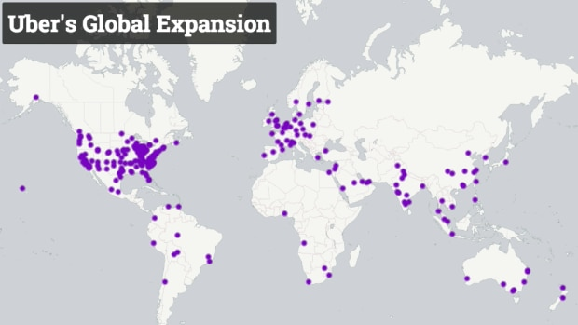
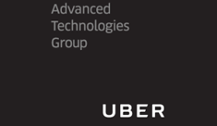
Future Goals: Uber
Try to Rebuild Image as “Uber 2.0”
The new Uber CEO Dara Khosrowshashi said that while the product and the board have been extraordinary, the culture, governance and the board went in bad directions. He also said that while Uber scaled as a business, it did not scale in terms of culture and winning gave excuses for bad behavior (Isaac, 2017) . The new leadership is now trying to change its culture and has come up with a set of new cultural norms for the company, with ‘We do the right thing. Period’ being one of them (Dickey, 2017). The company also seems to be striking a more conciliatory tone than earlier. It issued an open apology letter to Londoners for its mistakes and also said that it is willing to compromise and work with lawmakers in Brazil (Bennhold & Merced, 2017).
Diversify Business
Uber is focusing on diversification of B2C as well as B2B interests through ventures like UberEats, UberRush, and UberFreight. There is also a division called ‘UberEverything’ within the company, whose job is to identify opportunities outside of its ride business (Lien, 2016), (Russell, 2016).
[1] [2]
Continue Expansion
Though Uber has run into problems in countries like UK, it will continue to expand in places like Africa and Europe (Skydsgaard, 2017), (Roelf, 2017).
[3]
Go Public by 2019
Uber plans on going public by 2019, as the leadership believes that Uber is already in the public spotlight and has all the disadvantages of being public company, without any of the advantages (Fiegerman, 2017).
Invest in Autonomous Vehicles
Uber sees investment in Autonomous technology as existential to its future (Carson, 2016). Uber’s approach to autonomous technology can be classified as ‘Vertical Integration’ (Jones & George, 2016, p. 233). It established the Advanced Technology Group in 2015 to focus exclusively on the development of hardware and software related to autonomous technology (Uber, n.d.). This might mean that, in the future, we might see a fleet of autonomous Ubers primarily owned by Uber, and which runs on autonomous hardware and software developed by Uber.
[4]

Slide 13

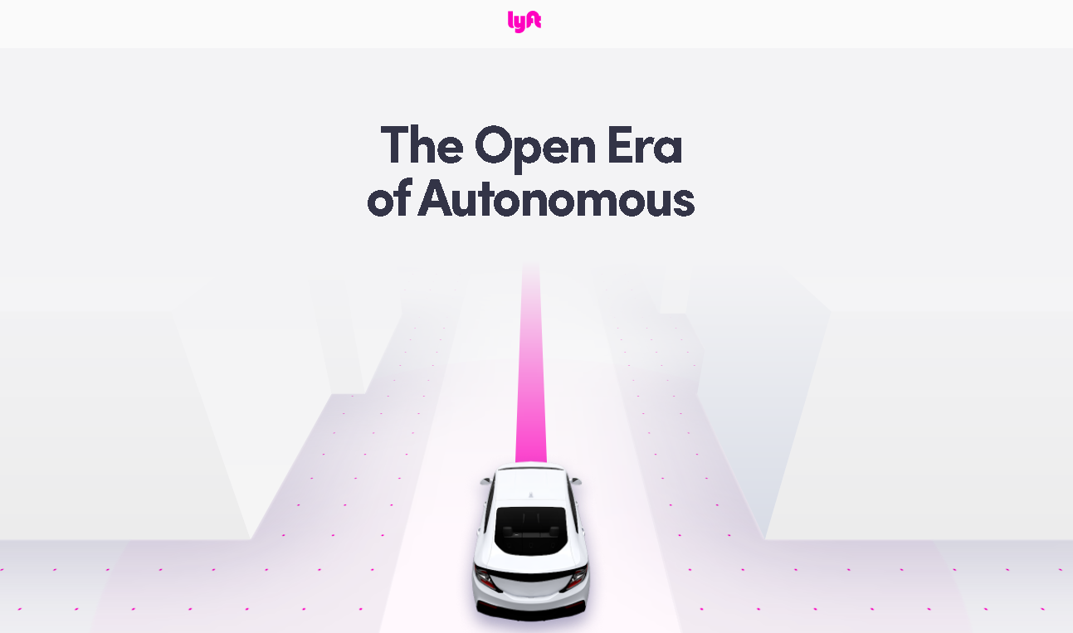
Future Goals : Lyft
Continue Being ‘Woke’
The co-founder of Lyft, John Zimmer, believes that what differentiates Lyft from Uber is that it is ‘Woke’ or more socially conscious. Lyft donated $1 million to the A.C.L.U. the same weekend as the #deleteuber campaign. The leadership at Lyft believes that they have a strong set of values around taking care of people who are part of the business, and they don’t want to win just for the sake of winning (Kosoff, 2017).
Continue Expansion
Lyft is expanding aggressively on domestic as well as international fronts. They are trying to expand to domestic areas where Uber doesn’t have a major presence, and also to internationally to countries like UK and Canada (Lyft, 2017), (Seppala, 2017).
Predicted to go Public by 2018
Lyft’s leaders have not been specific about going public, but many reports predict that Lyft will go public by 2018 (Isaac & Benner, 2017).
[5]
Invest in Autonomous Vehicles
Lyft’s co-founder, John Zimmer see autonomous technology as central to Lyft’s future. In fact, he has predicted that Autonomous vehicles will quickly become widespread and might account for a majority of Lyft rides within 5 years. He also predicts that private car ownership will end in major US cities by 2025, and most people would instead use ride sharing platforms like Lyft, and autonomous technology will be driving these changes (Zimmer, 2016). Unlike Uber, Lyft has a more collaborative approach to Autonomous technology. It has a first-of-its-kind open platform where its actively seeking to collaborate with leading technology and automobile companies in accelerating the growth of self-driving technology. Partnering with Lyft gives partners access to millions of rides through Lyft’s expansive network, exclusive set of data based on real-life scenarios to inform development and seamless integration through APIs, among other things (Lyft, n.d.). This might mean that, in the future, we might see a fleet of autonomous vehicle which operate on the Lyft Platform, where the cars can de owned by different companies like GM, and powered by autonomous technology by other companies like Waymo. In 2017, Lyft also announced plans of establishing its own facility to develop autonomous technology (Somerville, 2017).
[6]

Slide 14
SWOT : Uber
Our SWOT analysis has been informed by the analyses covered in the earlier sections of the report including the PEST analysis and the PORTER analysis
STRENGTHS
WEAKNESSES
OPPORTUNITIES
THREATS
STRENGTHS
WEAKNESSES
Market Leader
As of Sep 2017, Uber is reported to have almost 75% of the market share in US (Bhuiyan, 2017).
Valuation and Investors
Uber has been valued at close to $70 Billion, and is backed by many investors like Goldman Sachs and the Public Investment Fund of Saudi Arabia (Konigsberg, 2017).EXPLAIN WHY OR HOW THIS IS A STRENGTH
More Drivers
Uber is predicted to have more than 3 million drivers worldwide(Berry, 2017). EXPLAIN WHY/HOW THIS IS A STRENGTH
Global Reach
Uber has a presence in more than 80 countries and 700 cities (Uber, n.d.). EXPLAIN WHY/HOW THIS IS A STRENGTH
First-Mover Advantage
Uber has a first mover advantage over Lyft when it comes to most international markets. ARE THEY BENEFITING FROM THIS ALREADY? OTHERWISE I AM NOT SURE WE CAN SAY THEY CURRENT HAVE THE FIRST MOVER ADVANTAGE →It also has the first mover advantage when it comes to autonomous technology, as it established its Autonomous Technology group in 2015, while Lyft did something similar 2 years later (Somerville, 2017), (Uber, n.d.). WHAT DOES THAT MEAN? EXPLAIN HOW THIS IS A STRENGTH. WHY?
New Leadership Brings Experience and Vision - Uber’s new leadership includes CEO Dara Khosrowshahi who has overseen explosive growth at Expedia (Schaal, 2017). The leadership team has already brought in positive changes at Uber, including getting rid of older, aggressive cultural values like ‘toe-stepping’ and ‘principled confrontation’ and bringing in new ones like ‘We do the right thing’ (Dickey, 2017). - - THERE IS NOT ENOUGH INFO, MIGHT CONSIDER REMOVING THIS SO WE DON’T MAKE TOO MANY ASSUMPTIONS ABOUT WHAT COULD HAPPEN….WE ARE LOOKING AT THE CURRENT STATE.
Poor Public Image
Uber has been embroiled in a lot of issues lately, which has hampered its public image, resulting in campaigns such as #DeleteUber, where users were encouraged to delete their Uber apps (Bhuiyan, 2017). EXPLAIN WHY/HOW THIS IS A WEAKNESS
Obstructionist Attitude to Law & Regulations
Numerous Credible allegations of IP theft, bribery, sexism etc. (Levin, 2017). EXPLAIN WHY/HOW THIS IS A WEAKNESS
Company Culture Described as “Toxic”
Long work hours, cut-throat competition, blind eye turned to infractions from top performers (Isaac, 2017). EXPLAIN WHY/HOW THIS IS A WEAKNESS
Drivers Reportedly Dissatisfied
Drivers are reportedly unhappy as they feel they have to work long hours for less money(Hawkins, 2016). EXPLAIN WHY/HOW THIS IS A WEAKNESS
Profitability Seems Distant
In spite of all the progress, the company is still not profitable as of today, leading to questions if the business model would ever work (Mills, 2017). EXPLAIN WHY/HOW THIS IS A WEAKNESS

Slide 15
SWOT: Uber
STRENTGHS
WEAKNESSES
OPPORTUNITIES
THREATS
OPPORTUNITIES
THREATS
Autonomous Vehicles
Autonomous vehicles are predicted to have a transformative effect on society and business in the future and capitalizing on this technology represents a big opportunity for Uber (Walker, 2017, p. 9). WHY?
B2B and B2C Diversification
Continuing to invest in B2C and B2C opportunities like UberEats and UberFreights can help differentiate Uber with a wider, connected range of services (Lien, 2016), (Russell, 2016).
Develop Wider Network of Partners with Public and Private Sector
Utilizing global presence to develop a wider network of public and private partners is another opportunity which can help bring in / retain customers
Rivals Capitalizing on Poor public Image
Poor public image, is a threat for the company as rival companies may utilize it to gain exclusive access to certain locations where they can dominate the market. For example, Lyft is reportedly considering moving to London to capitalize on Uber’s ban (Titcomb, 2017).
Unhappy Drivers May Switch to Rivals
Uber’s unhappy drivers might switch to rival companies with possibilities of better pay (Valle, Bissel, & Kircher, 2016). This is a threat because Uber could lose many of their drivers. Without sufficient number of drivers, it will be difficult to operate on the same level as competitors.
Many Ongoing Lawsuits With Possible Large Fines
Uber has ongoing lawsuits which can lead to big fines, or even stunt its development of autonomous technology. The ongoing lawsuit with Waymo is a good example OF WHAT? (Metz, 2017). EXPLAIN WHY THIS IS A THREAT
High Level of Competition
The ride sharing and autonomous industry have a high level of competition with many major players like Tesla, Google, GM etc, and many of these companies are either working with Lyft and/or working on developing their own autonomous technology (Isaac, 2017), (Stewart, 2017). This presents a large threat to Uber BECAUSE WHY? (HINT: WHY IS COMPETITION A THREAT? WHAT ARE THE IMPLICATIONS?)

Slide 16
SWOT: Lyft
STRENGTHS
WEAKNESSES
OPPORTUNITIES
THREATS
STRENGTHS
WEAKNESSES
Friendly, Comparatively Unblemished Public Image
Lyft’s tagline ‘ Your friend with a car’ (intext citation?) speaks a lot about the service they offer. The company says that instead of an impersonal ride to your destination, in Lyft you are greeted with a fist bump and even welcomed to ride in the front seat of the car. Lyft comparatively unblemished image is because of its mostly accommodating approach (per the CSR analysis) towards corporate social responsibility as opposed to obstructionist approach which Uber tends to adopt (per the CSR analysis). EXPLAIN WHY THIS IS A STRENGTH.
Open, Collaborative Culture
The company works hard to maintain a positive culture, empowers its employee to participate and make it happen (intext citation). The company has collaborated with Ola Cabs in India and Didi Chuxing in China to expand in South East Asian parts (intext citation). EXPLAIN WHY THIS IS A STRENGTH.
Happier Drivers
About 75.8 percent of lyft drivers reported that they were happy with their job as compared to 49.8 percent of Uber drivers (The Verge,2017). EXPLAIN WHY THIS IS A STRENGTH.
Geographically Limited, Lower Market Share and Recognition
Its presence is restricted in the US as of now and its competitor, uber, has presence in international markets. Lyft is valued at $11 billion while uber’s valuation is $68 billion. The company’s low market share and low valuation could act as a hinderance for getting more funding. EXPLAIN WHY THIS IS A WEAKNESS.
Fewer Drivers
As of now, Uber has more number of drivers working for it as compared to the numbers for lyft. Uber has 1.5 million drivers while Lyft has 700,000 as of now (Lyft Stats, 2017). EXPLAIN WHY THIS IS A WEAKNESS.
Late to Invest in Autonomous Vehicles
Uber is way ahead in autonomous technology space. Uber’s self-driving cars are out in the steel city, Pittsburg for testing. EXPLAIN WHY THIS IS A WEAKNESS.

Slide 17
SWOT: Lyft
STRENTGHS
WEAKNESSES
OPPORTUNITIES
THREATS
OPPORTUNITIES
THREATS
Capitalizing on Uber’s Blunders
Uber has been kicked out of certain places such as London due to its engagement in unethical practices (intext citation). Lyft can enter strategically to those markets and increase its market share.
Global Expansion
Since most of the competition is from global markets in which Uber has expanded (intext citation), Lyft can take initiatives and either enter those markets or partner up with local service providers there.
Partnership with Alphabet’s Waymo
Lyft’s collaboration with Waymo for autonomous vehicles can prove to be a huge success (intext citation). Uber is using in-house technology for self-driving vehicles, while Lyft’s collaboration with Waymo can prove to be beneficial because of it is one of the pioneers in the field (intext citation).
Lyft Open Platform
With Lyft’s open platform, the world's best car manufacturers and self-driving systems can plug into our network of nearly one million rides per day (intext citation). Access to a diverse set of real-life scenarios helps partners develop their systems around actual experiences and behaviours (intext citation).
Rival Development of Autonomous Vehicles
Uber is already carrying out testing of their first self-driven car in Pittsburg (intext citation). This can be a threat to Lyft as it is lagging behind in the autonomous vehicle arena. EXPLAIN WHY THIS IS A THREAT? HOW DO YOU KNOW?
Ongoing Lawsuits Regarding Labor Practices
Some of the current and pending lawsuits can impact Lyft’s reputation and result in financial loss in carrying out settlements.
Vulnerable to Industry Regulations and Perceptions Developed in Response to Uber
At some of the places ride-sharing companies have been under scrutiny and some places have also put an upper cap on the number of cars that can be allowed on the streets (intext citation). This might prove to be a threat to Lyft. WHY?

Slide 18
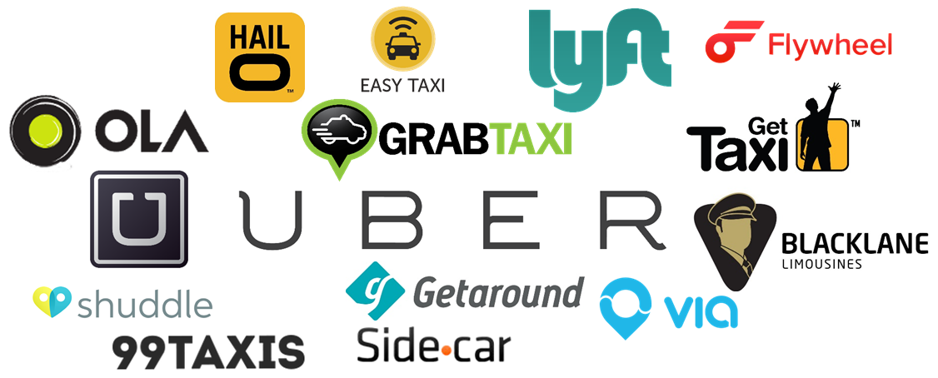
Predictions
To address the objection, both Uber and Lyft will be present and operating in the next 5 years however, there will still be a gap between Uber and Lyft. The following specific predictions based on the current status of the companies and the completed analysis of external and internal factors, and future goals. The recommendations section (will follow predictions section) will attempt to address and potentially redirect the trajectory in which the companies are heading at this point in time.
01
RIDESHARING MARKET WILL GROW
The general trend of people observed these days is that they are moving from private ownership of vehicles or public transport to ride sharing because of cost, convenience and the comfort they provide (intext citation). More ride sharing competitors such as Curb, Fasten, Ola, SideCar, Taxify, Haxi, Summon, Juno are already in the market and the number may continue grow due to the NEED TO EXPAND, BRIEFLY TALK ABOUT WHY YOU THINK SO. (intext citation).
OTHER PLAYERS:
Curb: Formerly Taxi Magic (2009) and RideCharge (2007), Curb was born in 2014, and is a company that connects people with safe, reliable rides from professional, insured, and fully licensed taxi and other for-hire drivers.
Didi Chuxing: Conceived from a merger back in 2015, Didi Chuxing is a ride-hailing service company made up of China's two largest taxi-hailing firms: Didi Dache and Kuaidi Dache. Didi Chuxing, formerly known as Didi Kuaidi, is often referred to as the "Uber of China," and virtually owns all of China's taxi-hailing market, with 99% market share, and 87% market share when it comes it hailing private vehicles.
Fasten Inc. is an American transportation network company based in Boston, Massachusetts. Founded in 2015 by CEO Kirill Evdakov, CMO Roman Levitskiy and COO Vlad Christoff, Fasten was first launched in September 2015 in Boston.
02
UBER WILL MAINTAIN LEAD OVERALL
Current market leadership, first-mover advantage, financial support, global outreach, and diverse products provide a robust advantage. Uber’s diversified business and venturing into UberEats, presence in 74 countries, $70 billion valuation and series of funding from investors over fifteen rounds has made uber a strong player in the market making it difficult for any rideshare company to catch up (intext citation). Therefore, with the current status, it is predicted that Uber will maintain the lead over in the market.

Slide 19
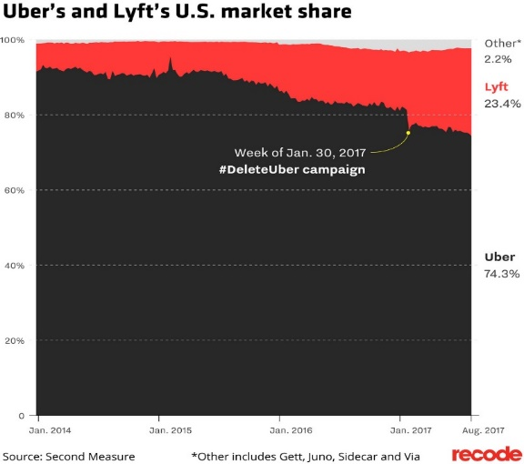
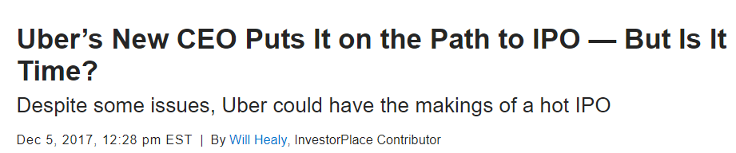
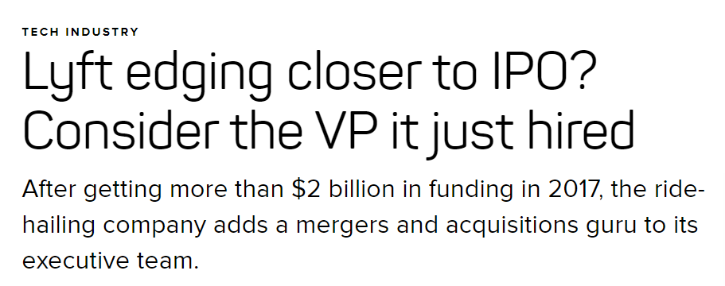
Predictions (continued)
03
LYFT WILL INCREASE ITS MARKET SHARE IN THE U.S.
Since the beginning of 2014, Uber has gone from owning 91 percent* of the U.S. ride-sharing market down to 74.3 percent as of this month (intext citation). According to data from Second Measure, a research firm that tracks billions of dollars in anonymized credit card purchases (intext citation). The biggest decrease in Uber’s market share happened during the week of Jan. 30, when the #deleteUber campaign was in full swing (intext citation). Customers wielded the hashtag against the company for trying to profit during a protest against Trump’s Muslim ban that included a strike by New York City’s taxi union (intext citation). Lyft’s market share has been rising continually in the past year, at the expense of Uber’s (intext citation). Therefore, our team predicts, at this rate, Lyft’s market share is projected to continue to increase as backlash to Uber continues and the Lyft brand gains more recognition.
04
UBER’S REPUTATION WILL BE A LIABILITY
#DeleteUber
Uber has faced lawsuits, the allegations of sexual harassment in the workplace, self-driving car mishaps. It’s perception in the market has been negative (intext citation) and there is a high cost to a bad reputation (intext citation). Uber was banned from operating in London because of all these reasons (intext citation). Uber’s negative reputation opens up opportunities for Lyft to strategically enter those markets to gain a competitive (and exclusive) advantage over Uber. Thus, at this rate, it is predicted that Uber’s reputation will continue to be liability.
05
BOTH COMPANIES WILL GO PUBLIC
As of now, both companies are being run by private investors who have a lot of say in the way the company operate. Once both the companies go public, a lot of dynamics will change. For example…

Slide 20




Recommendations for Uber
Uber has hired a new CEO who has already begun sharing his more vision of a more ethical Uber (intext citation). Uber is moving in the right direction by changing up the leadership as it can initiate a shift in company values and ethics, as these two factors are heavily influenced from the top down (intext citation). To ensure Uber’s best chances of success, the team recommends that the current Chairman be replaced (The current Chairman may maintain a seat at the Board but with significantly less influence/leadership responsibilities.). Under his leadership, the company has failed to make ethical and legal decisions in the past. This behavior and ideals in the leader is difficult to change (intext citation). Therefore it will be more effective to hire a new, third party chairman to collaborate with the new CEO to move the company towards a more ethical and law-abiding company. Engaging in more ethical business practices will improve the company’s image (intext citation). This improved image will build trust and overall bring in more customers (intext citation).
During the transition from Uber 1.0 to Uber 2.0 (specifically regarding the change in management and ethical practices), Uber employees may need some direction and knowledge to assist with the transition. This can be done by hiring ethical consultants to train employees on ethical business practices once a quarter for the next year or two. Though this may not have a significant and/or immediate effect, as ethics and values are generally from the top down (intext citation), this will inform employees and give them a choice on how to act or shape their recommendations to management about Uber’s business strategies. This recommendation’s goal is to prepare the environment for a change in a more ethical direction by instigating a shift in norms between the employees as a whole.
The team recommends that Uber remove their stacked ranking system and replace it with a 360 feedback to address issues regarding Uber’s current organizational culture. It understandable that Uber wants to have the best of the best workforce where only the most motivated and hard-working individuals are employed within their company. However, the stacked ranking puts employees on a bell curve with strict cutoffs which breeds competition, sabotage, feelings of being under appreciate, and ultimately creates a toxic work culture (Nisen, 2013). The 360 feedback will allow managers and subordinates to both communicate with each group as well as with each other to find middle ground and solutions without fear or intimidation (intext citation). This new culture of collaboration, trust, empathy, and more open communication. Together these factors will decrease employee discontent which will motivate employees to want to work harder (in a healthy way) to meet organization goals (intext citation).

Slide 21



Recommendations for Lyft
Currently, through the analysis, one of Lyft’s sources of competitive advantage lies in its reputation of engaging in ethical business practices (which also appears to have also been integrated into its brand). Therefore, to maintain this advantage as well as its brand, the team recommends that Lyft assemble third party ethical committee to advise and keep Lyft’s business practices in compliance with the law and society ethics. Once again, the emphasis and purpose of this recommendation is not to change any values or business practices but to ensure a continued compliance with ethical and legal business practices in an advisory capacity. For example, if Lyft’s new strategy or policy lies in a gray area, the committee may advise on the ethical implications. The committee(s) will consist of 3 to 5 members who have no personal or professional relation to Lyft. The committee will not be told which company they are working with to ensure there are no biases in their ethical and legal evaluation, and advice to Lyft.
The team recommends that Lyft leverage their reputation and community focus to specifically target and establish exclusive access with communities/municipalities which have explicitly rejected Uber. Depending on available funding, Lyft can begin by creating 1 to 2 teams consisting of 2 to 3 individuals to spend time at these locations speaking to regulators and legislators to address and propose mitigation strategies to any of theirs and their communities’ concerns. This recommendation aims to accomplish the following: 1) Cost-efficient and targeted expansion. Lyft is able to spend less time evaluating new locations to expand to as Uber has already done so and deemed these target locations a good market for rideshare. Lyft can now only focus their resources on convincing regulators and communities instead. 2) Establish exclusive access to communities where Lyft will have an advantage over Uber (as Uber will not be operating in these areas).
The team recommends Lyft to utilized already established collaborative platform (intext citation) to create strategic partnerships with other companies with similar values and ethical business practices such as Tmobile, PCC, and Toms. These partnerships aim to accomplished three goals: 1) Reinforce each other’s values and ethics. By reinforcing their values, Lyft may be able to pull customers who are loyal to these partner brands to their services. They can reach another group of customers, assuming they do not already overlap significantly. 2) Provide platform for marketing. For example, partner companies could send free samples or sell their products within Lyft vehicles and in exchange, Lyft’s logo will be advertised on the product packaging. 3) Furthermore, if and when Lyft begins to aggressively expand, utilizing these partnerships provides a cost-effective way to market their services/brand. At the same time, establishing trust by associating their brand with already established companies within the community.

Slide 22
references
QUICK FACTS
Allen, S. (2017). Why Uber could struggle to stay on top of the ride-hailing market. Retrieved from http://marketrealist.com/2017/08/why-uber-could-struggle-to-stay-on-top-of-the-ride-hailing-market
Bensinger, G. (2017). SoftBank seeks Uber shares at 30% discount from $68 billion valuation. Retrieved from https://www.marketwatch.com/story/softbank-seeks-uber-shares-at-30-discount-from-68-billion-valuation-2017-11-27?siteid=rss&rss=1
Isaac, M and Benner, K. (2017). Lyft, exploring IPO., raises $1 billion led by Google's parent. Retrieved from https://www.cnbc.com/2017/10/20/new-york-times-digital-lyft-exploring-i-p-o-raises-1-billion-led-by-googles-parent.html
Lyft, Inc. (2017). Cities. Retrieved December 6, 2017, from https://www.lyft.com/cities
Lyft. [Lyft]. (2013, March 16). "Our mission is to reconnect people through transportation and bring communities together." [Tweet]. Retrieved from https://twitter.com/lyft/status/577558134698348544?lang=en
Sacca, C. (2015). Why I’d never want to compete with Uber’s Travis Kalanick. Retrieved from http://fortune.com/2015/02/04/why-id-never-want-to-compete-with-ubers-travis-kalanick/
Shontell, A. and Lebowitz, S. (2017). Lyft's cofounder didn't take a salary for 3 years and slept on a couch in an “apartfice” before his company was worth $11 billion. Retrieved from http://www.businessinsider.com/how-john-zimmer-and-logan-green-founded-lyft-2017-10
Uber Technologies, Inc. (2017). Uber cities across the globe. Retrieved December 6, 2017, from https://uber.com/cities
John Zimmer Image. Retrieved from https://upload.wikimedia.org/wikipedia/commons/thumb/1/16/John_Zimmer.jpg/220px-John_Zimmer.jpg
Logan Green Image. Retrieved from https://media-exp2.licdn.com/mpr/mpr/shrinknp_200_200/AAEAAQAAAAAAAAeGAAAAJDM5ZmMxYWI5LTFmYTgtNGE3MC1hZjQ4LTc2OTVmNDdjMGI4MQ.jpg
Garrett Camp Image. Retrieved from https://images.celebfamily.com/wp-content/uploads/2016/06/Garrett-Camp-Alchetron.jpg
Travis Kalanick Image. Retrieved from https://upload.wikimedia.org/wikipedia/commons/thumb/3/31/Travis_Kalanick_at_DLD_Munich_2015_%28cropped%29.jpg/220px-Travis_Kalanick_at_DLD_Munich_2015_%28cropped%29.jpg
ORGANIZATIONAL STRUCTURE & ORGANIZATIONAL CULTURE
Bershidsky, L. (2017). Uber’s big problem is a culture of dishonesty. Bloomberg. Retrieved November 22, 2017, from https://www.bloomberg.com/view/articles/2017-11-22/uber-s-big-problem-is-a-culture-of-dishonesty
Buchanan, L. (2017). Lyft’s CEO on creating a great company culture. Retrieved December 6, 2017, from https://www.inc.com/magazine/201506/leigh-buchanan/logan-green-on-employee-recognition.html
Cakebread, C. (2017, June 14). These are the 47 things Uber has agreed to do to change its company culture. Retrieved from http://www.businessinsider.com/47-ways-uber-is-changing-its-culture-2017-6/#changes-to-leadership-1
Griswold, A. (2017). Uber internal performance reviews mean that for one employee to get ahead, another must fail. Retrieved December 6, 2017, from https://qz.com/918582/uber-is-designed-so-that-for-one-employee-to-succeed-another-must-fail/
Jones, G. R., & George, J. M. (2016). Contemporary management (9th ed.). New York, NY: McGraw-Hill Education.
O'Donovan, C. (2017, July 17). How Uber's hard-charging corporate culture left employees drained. Retrieved https://www.buzzfeed.com/carolineodonovan/how-ubers-hard-charging-corporate-culture-left-employees?utm_term=.tdr89N8xJ#.ff7b37blZ
Oliver, M. (2017, July 18). Culture and hyper growth: Ron Storn on keeping Lyft’s values alive. Retrieved https://www.humansynergistics.com/resources/content/2017/07/18/culture-and-hyper-growth-ron-storn-on-keeping-lyft-s-values-alive

Slide 23
references
ANALYSIS: PEST
Charpentrat, J. (2017). Investors fuel a multibillion-dollar ride-sharing frenzy. Retrieved December 5, 2017, from https://www.yahoo.com/news/investors-fuel-multibillion-dollar-ride-sharing-frenzy-013110087.html
Descant, S. (2017). Are ride-shares and gas prices behind falling transit ridership? Retrieved December 5, 2017, from http://www.govtech.com/fs/infrastructure/Are-Ride-Shares-and-Gas-Prices-Behind-Falling-Transit-Ridership.html
Gartner. (2017). Gartner Hype Cycle for emerging technologies, 2017.
Gilbert, S. (2017). The movement of #MeToo. Retrieved from https://www.theatlantic.com/entertainment/archive/2017/10/the-movement-of-metoo/542979/
Knight, S. (2017). US mobile trends report: smartphone penetration, upgrade cycles, connected cars and more - TechSpot. Retrieved December 5, 2017, from https://www.techspot.com/news/71753-us-mobile-trends-report-smartphone-penetration-upgrade-cycles.html
Meredith, S. (2017). Goldman raises 2018 oil price forecast after OPEC deal. Retrieved December 5, 2017, from https://www.cnbc.com/2017/12/05/goldman-raises-2018-oil-price-forecast-after-opec-deal.html
Montgomery, C. A. (2015, September). The on-demand economy. Harvard Business School Technical Note 716-405.
Newcomer, E. (2017). Uber Paid Hackers to Delete Stolen Data on 57 Million People - Bloomberg. Retrieved November 22, 2017, from https://www.bloomberg.com/news/articles/2017-11-21/uber-concealed-cyberattack-that-exposed-57-million-people-s-data
ANALYSIS: SOCIAL RESPONSIBILITY
Bensinger, G. (2016). Uber, Lyft oppose Seattle’s draft union rules - wsj. retrieved november 22, 2017, from https://www.wsj.com/articles/uber-lyft-oppose-seattles-draft-union-rules-1479936176
Bershidsky, L. (2017). Uber’s big problem is a culture of dishonesty - Bloomberg. Retrieved November 22, 2017, from https://www.bloomberg.com/view/articles/2017-11-22/uber-s-big-problem-is-a-culture-of-dishonesty
Felton, R. (2017). Lyft is not a “better boyfriend.” Retrieved November 22, 2017, from https://jalopnik.com/lyft-is-not-a-better-boyfriend-1793772573
Ingram, D. (2017). What is at stake for Uber in U.S. bribery probe? Retrieved November 22, 2017, from https://www.reuters.com/article/us-uber-corruption/what-is-at-stake-for-uber-in-u-s-bribery-probe-idUSKCN1BW0HH
Jones, G. R., & George, J. M. (2016). Contemporary management (9th ed.). New York, NY: McGraw-Hill Education.
Khosrowshahi, D. (2017). 2016 data security incident. Retrieved November 22, 2017, from https://www.uber.com/newsroom/2016-data-incident/
Newcomer, E. (2017). Uber paid hackers to delete stolen data on 57 million people - Bloomberg. Retrieved November 22, 2017, from https://www.bloomberg.com/news/articles/2017-11-21/uber-concealed-cyberattack-that-exposed-57-million-people-s-data
O’Brien, R. D., & Bensinger, G. (2017, September 8). Uber faces FBI probe over program targeting rival Lyft; investigators looking at whether Uber’s defunct “Hell” internal program was used to interfere illegally with competitors. The Wall Street Journal. New York, NY.
Somerville, H. (2017). Judge approves $27 million driver settlement in Lyft lawsuit. Retrieved November 22, 2017, from https://www.reuters.com/article/us-lyft-drivers/judge-approves-27-million-driver-settlement-in-lyft-lawsuit-idUSKBN16N30D
Steinmetz, K. (2017, September). How Lyft is capitalizing on Uber’s scandals. Time.

Slide 24
references
ANALYSIS: PORTER’S 5 FORCES
Konczal, M. (2014). Socialize Uber. Retrieved December 5, 2017, from https://www.thenation.com/article/socialize-uber/
Molla, R., & Bhuiyan, J. (2017). Uber hasn’t recovered its business in San Francisco and New York since #deleteUber - Recode. Retrieved December 5, 2017, from https://www.recode.net/2017/11/8/16617798/uber-delete-uber-lyft-market-share-sales
FUTURE GOALS & SWOT
Berry, M. (2017, November 3). How Many Uber drivers are there? Retrieved from https://therideshareguy.com/how-many-uber-drivers-are-there/
Bezek, I. (2016, December). Will Uber ever make money? - Bezek's Daily Briefing. Retrieved from https://seekingalpha.com/article/4031752-will-uber-ever-make-money-bezeks-daily-briefing
Cava, M. d. (2017, June 13). Uber has lost market share to Lyft during crisis. Retrieved from https://www.usatoday.com/story/tech/news/2017/06/13/uber-market-share-customer-image-hit-string-scandals/102795024/
Dawson, J. (2017, March 2). Travis Kalanick has no one but himself to blame for Uber's toxic company culture. Retrieved from https://www.recode.net/2017/3/2/14794092/uber-ceo-travis-kalanick-company-culture-toxic-values
Dent, S. (2017, July 24). “Partner” Didi Chuxing is freezing Uber out of Southeast Asia. Retrieved from https://www.engadget.com/2017/07/24/didi-chuxing-softbank-grab-freezing-uber/
Hawkings, A. J. (2018, Jan 18). Lyft drivers are happier than Uber drivers (probably because they earn more). Retrieved from https://www.theverge.com/2017/1/18/14311540/uber-lyft-drivers-satisfaction-survey-rideshare-guy
Henderson, P. (2017, November 3). U.S. judge deals setback to Waymo damage claim in Uber lawsuit. Retrieved from https://www.reuters.com/article/us-alphabet-uber-lawsuit/u-s-judge-deals-setback-to-waymo-damage-claim-in-uber-lawsuit-idUSKBN1D32J0
Isaac, M. (2017, May 14). Lyft and Waymo reach deal to collaborate on self-driving cars. Retrieved from https://www.nytimes.com/2017/05/14/technology/lyft-waymo-self-driving-cars.html
Isaac, M. (2017, July 21). Lyft to develop self-driving car technology in new Silicon Valley facility. Retrieved from https://www.nytimes.com/2017/07/21/technology/lyft-self-driving-car-technology.html
Isaac, M. (2017, November 9). Uber 2.0: New CEO wants to put his stamp on the company. Retrieved from https://www.nytimes.com/2017/11/09/business/dealbook/uber-ceo-dara-khosrowshahi.html
Jackson, T. (2017, April 24). Blocked traffic, immolated cars: Uber’s problems in Africa. Retrieved from http://fortune.com/2017/04/24/uber-problems-africa-expansion/
Kerr, D. (2017, September 14). Lyft said to be eyeing international expansion. Retrieved from https://www.cnet.com/news/lyft-said-to-be-eyeing-international-expansion/
Kosoff, M. (2017, September 19). The Lyft guys reveal their kinder, gentler plan to crush Uber. Retrieved from https://www.vanityfair.com/news/2017/09/lyft-co-founders-interview
Levin, S. (2017, June 27). Uber's scandals, blunders and PR disasters: The full list. Retrieved from https://www.theguardian.com/technology/2017/jun/18/uber-travis-kalanick-scandal-pr-disaster-timeline
Lien, T. (2016, May 11). Lyft offers to pay $27 million to settle a lawsuit by drivers seeking employee status. Retrieved from http://www.latimes.com/business/technology/la-fi-tn-lyft-revised-settlement-20160511-snap-story.html
UberBlog. (2017, September 1). A winning combination: Uber and public transit. Retrieved from https://www.uber.com/blog/seattle/a-winning-combination-uber-and-public-transit/
PREDICTIONS
Molla, R., & Bhuiyan, J. (2017). Uber hasn’t recovered its business in San Francisco and New York since #deleteUber - Recode. Retrieved December 5, 2017, from https://www.recode.net/2017/11/8/16617798/uber-delete-uber-lyft-market-share-sales
RECOMMENDATIONS (NEW CITATION FROM HYE)
Nisen, M. (2013). Why Stack Ranking is Terrible Way to Motivate Employees. Retrieved from http://www.businessinsider.com/stack-ranking-employees-is-a-bad-idea-2013-11

Slide 25
references
Future Goals: Uber
Bennhold, K., & Merced, M. J. (2017, Oct 3). Uber C.E.O. Aims to Win Back London. Retrieved from https://www.nytimes.com/2017/10/03/business/uber-london-dara-khosrowshahi.html
Carson, B. (2016, Aug 18). Travis Kalanick on Uber's bet on Self-Driving Cars: 'I can't be wrong'. Retrieved from http://www.businessinsider.com/travis-kalanick-interview-on-self-driving-cars-future-driver-jobs-2016-8
Dickey, M. R. (2017, Nov 7). These are Uber’s new ‘cultural norms’. Retrieved from https://techcrunch.com/2017/11/07/these-are-ubers-new-cultural-norms/
Fiegerman, S. (2017, Nov 9). Uber CEO says company plans to go public in 2019. Retrieved from http://money.cnn.com/2017/11/09/technology/uber-ipo-2019/index.html
Isaac, M. (2017, Nov 9). Uber 2.0: New C.E.O. Wants to Put His Stamp on the Company. Retrieved from https://www.nytimes.com/2017/11/09/business/dealbook/uber-ceo-dara-khosrowshahi.html
Jones, G. R., & George, J. M. (2016). Contemporary Management. New York: McGraw Hill Education.
Lien, T. (2016, May 7). Uber conquered taxis. Now it's going after everything else. Retrieved from http://www.latimes.com/business/technology/la-fi-tn-uber-everything-snap-story.html
Roelf, W. (2017, Nov 7). Uber bullish on Africa despite opposition from local taxi firms. Retrieved from https://af.reuters.com/article/africaTech/idAFL5N1ND4X8
Russell, J. (2016, Sep 27). Uber-owned Otto to offer freight hauling services using autonomous trucks in 2017. Retrieved from https://techcrunch.com/2016/09/27/uber-otto-freight-services-2017/
Skydsgaard, N. (2017, April 18). Uber eyes EU expansion despite Denmark setback, looming EU court ruling. Retrieved from https://ca.reuters.com/article/technologyNews/idCAKBN17K22V-OCATC
Uber. (n.d.). Advanced Technologies Group. Retrieved from https://www.uber.com/info/atg/
Image Citations
[1] -From https://www.uber.com/newsroom/media-assets/
[2] - From https://www.appdupe.com/uber-rush-logo/
[3] - From https://medium.com/global-intersection/sharing-economy-challenges-with-global-expansion-b54b62372750
[4] - From https://www.linkedin.com/company/uber-advanced-technologies-group?trk=company_logo
Future Goals – Lyft
Isaac, M., & Benner, K. (2017, Oct 20). Lyft, Exploring I.P.O., Raises $1 Billion Led by Google's Parent. Retrieved from https://www.cnbc.com/2017/10/20/new-york-times-digital-lyft-exploring-i-p-o-raises-1-billion-led-by-googles-parent.html
Kosoff, M. (2017, Sep 19). THE LYFT GUYS REVEAL THEIR KINDER, GENTLER PLAN TO CRUSH UBER. Retrieved from https://www.vanityfair.com/news/2017/09/lyft-co-founders-interview
Lyft. (2017, Jan 26). Lyft Kicks Off Massive Expansion, Launching 40 Cities. Retrieved from https://blog.lyft.com/posts/lyft-launches
Lyft. (n.d.). The Open Era of Autonomous. Retrieved from https://take.lyft.com/open-platform/
Seppala, T. J. (2017, Nov 13). Lyft's international expansion begins this year in Toronto. Retrieved from https://www.engadget.com/2017/11/13/lyft-toronto/
Somerville, H. (2017, Sep 7). Lyft to offer rides in self-driving cars in San Francisco area. Retrieved from https://www.reuters.com/article/us-lyft-selfdriving/lyft-to-offer-rides-in-self-driving-cars-in-san-francisco-area-idUSKCN1BI1R0
Zimmer, J. (2016, Sep 18). The Road Ahead. Retrieved from https://medium.com/@johnzimmer/the-third-transportation-revolution-27860f05fa91

Slide 26
references
Future Goals – Lyft (Continued)
Image Citations
[5] -From https://blog.lyft.com/posts/lyft-launches
[6] - https://take.lyft.com/open-platform/
SWOT - Uber -Strengths and Weaknesses
Berry, M. (2017, November 3). How Many Uber Drivers Are There? Retrieved from https://therideshareguy.com/how-many-uber-drivers-are-there/
Bhuiyan, J. (2017, Nov 7). Uber’s U.S. sales have recovered after the #deleteUber campaign but Lyft is still gaining. Retrieved from https://www.recode.net/2017/11/5/16599156/uber-business-market-share-lyft-scandal-delete-uber
Hawkins, A. J. (2016, Feb 15). Uber drivers say that driving for Uber kind of sucks. Retrieved from https://www.theverge.com/2016/2/15/11004250/uber-drivers-survey-satisfaction-rideshare-guy
Isaac, M. (2017, Feb 22). Inside Uber’s Aggressive, Unrestrained Workplace Culture. Retrieved from https://www.nytimes.com/2017/02/22/technology/uber-workplace-culture.html?mtrref=www.google.com&gwh=617BB22A0B4E8C9CCBA83A6C1E39BA3B&gwt=pay
Konigsberg, R. (2017, June 13). Uber's Top Investors. Retrieved from https://www.investopedia.com/insights/ubers-top-investors/
Levin, S. (2017, June 27). Uber's scandals, blunders and PR disasters: the full list. Retrieved from https://www.theguardian.com/technology/2017/jun/18/uber-travis-kalanick-scandal-pr-disaster-timeline
Mills, C. (2017, April 14). Uber can't stop losing money. Retrieved from http://bgr.com/2017/04/14/uber-2016-profit-loss-financials/
Schaal, D. (2017, Aug 28). Can Uber’s New CEO Dara Khosrowshahi Turn It Around Like He Did Expedia? Retrieved from https://skift.com/2017/08/28/can-ubers-new-ceo-dara-khosrowshahi-turn-it-around-like-he-did-expedia/
Uber. (n.d.). Uber cities around the Globe. Retrieved from https://www.uber.com/cities/
Somerville, H. (2017, Sep 7). Lyft to offer rides in self-driving cars in San Francisco area. Retrieved from https://www.reuters.com/article/us-lyft-selfdriving/lyft-to-offer-rides-in-self-driving-cars-in-san-francisco-area-idUSKCN1BI1R0
Uber. (n.d.). Advanced Technologies Group. Retrieved from https://www.uber.com/info/atg/
Dickey, M. R. (2017, Nov 7). These are Uber’s new ‘cultural norms’. Retrieved from https://techcrunch.com/2017/11/07/these-are-ubers-new-cultural-norms/
SWOT -Uber - Opportunities and Threats
Isaac, M. (2017, June 6). Playing Catch-Up to Uber on Self-Driving, Lyft Teams Up With Partners. Retrieved from https://www.nytimes.com/2017/06/06/technology/lyft-self-driving-nutonomy-partnership.html?mtrref=www.google.com&gwh=F608EA6B556C429917218EB03291AD6F&gwt=pay
Metz, C. (2017, Nov 28). Rebuking Uber Lawyers, Judge Delays Trade Secrets Trial. Retrieved from https://www.nytimes.com/2017/11/28/technology/uber-waymo-lawsuit.html?mtrref=www.google.com&gwh=D2BB3C35430F1C1A835E711A8D0A4FFF&gwt=pay
Stewart, J. (2017, May 10). MAPPED: THE TOP 263 COMPANIES RACING TOWARD AUTONOMOUS CARS. Retrieved from https://www.wired.com/2017/05/mapped-top-263-companies-racing-toward-autonomous-cars/

Slide 27
references
SWOT -Uber - Opportunities and Threats (Continued)
Titcomb, J. (2017, Sep 27). More pain for banned Uber as arch-rival Lyft moves in on London market. Retrieved from http://www.telegraph.co.uk/technology/2017/09/23/uber-arch-rival-lyft-holds-talks-transport-london-plots-global/
Valle, S. D., Bissel, J., & Kircher, D. (2016). For anyone who switched to driving for Lyft from Uber, why did you choose to switch? Retrieved from https://www.quora.com/For-anyone-who-switched-to-driving-for-Lyft-from-Uber-why-did-you-choose-to-switch
Walker, M. J. (2017). Hype Cycle for Emerging Technologies, 2017. Gartner.
Lien, T. (2016, May 7). Uber conquered taxis. Now it's going after everything else. Retrieved from http://www.latimes.com/business/technology/la-fi-tn-uber-everything-snap-story.html
Russell, J. (2016, Sep 27). Uber-owned Otto to offer freight hauling services using autonomous trucks in 2017. Retrieved from https://techcrunch.com/2016/09/27/uber-otto-freight-services-2017/

